Slide 1
Course Title & Description
MFET 25000: Smart Manufacturing Cloud Computing Applications
An introduction to the concepts and principles of cloud computing and the virtualization of computing resources and services for smart manufacturing applications. The fundamental topics of cloud computing will be addressed, including virtually processing, storing, modeling and analyzing manufacturing data in the cloud environment. Fundamental concepts about cloud tools, apps, and services from a production and manufacturing perspective will be presented.

Slide 2
Course Details
Course Prerequisite:
CNIT 15501 Intro. to Software Development Concepts
Course introduces fundamental software development concepts common to most programming languages. Topics include problem solving and algorithm development, debugging, programming standards, variables, data types, operators, decisions, repetitive structures, modularity, arrays, user interface construction, software testing and debugging. A broad range of examples will be used throughout the course to show how each programming concept applies to real life problems.
Course Credits: 3 Credit Hours
Delivery Method:
a. 3 x 50 min lectures/week
b. 1 x 110 min lab/week
c. 15-weeks/semester + 1-week for finals

Slide 3
Course: MFET 25000: Smart Manufacturing Cloud Computing Applications
Topics/Concepts | Learning Outcomes | Level⁺ | Technology/Tools | ABET Criterion 3
Foundations of Cloud Computing for Smart Manufacturing Principles of Cloud Computing Cloud Computing Services (IaaS, PaaS, & SaaS) Cloud Computing Architectures, Advantages/Disadvantages of Cloud Paradigms Economic Benefits | Demonstrate understanding and application of cloud computing for smart manufacturing | Understanding Applying | Microsoft Azure Cloud | 1 - an ability to apply knowledge, techniques, skills and modern tools of mathematics, science, engineering, and technology to solve broadly defined engineering problems appropriate to the discipline;
Industrial IoT (IIoT) Cloud Infrastructure - PAAS Principles of IoT & Industrial IoT in Cloud Developing Industrial IoT Applications in Hybrid (Cloud/Edge) and Cloud Development Models (DevOps), Cloud Data Storage Services Ingestion & Curation of Data (Stream & Batch Processing) High Availability & Disaster Recovery (HA/DR) Scale, Agility, & Cost Models | Apply the models, tools, and service types offered by the cloud platforms to build IIoT infrastructure for smart manufacturing Deploy physical devices, configure and maintain them by using cloud services throughout the device lifecycle. | Understanding Applying | Microsoft Azure Cloud, Azure IoT Central, GitHub for Code Repository, Python, MATLAB | 4 - an ability to conduct standard tests, measurements, and experiments and to analyze and interpret the results to improve processes
Software as a Service in Cloud – SAAS Business Specific Software Applications (MES, ERP, CRM, SCM, etc) Machine & Process Specific Software Applications Software Cost Models Data Compliance & Sovereignty | Analyze IIoT data with machine learning for specific machines and processes. | Evaluating Analyzing | Business Specific Software (MES, ERP, CRM, SCM), Python, MATLAB, Azure ML, Azure IoT Central | 4- an ability to conduct standard tests, measurements, and experiments and to analyze and interpret the results to improve processes
Securing Manufacturing Applications and Data in the Cloud Security in IaaS, PaaS, and SaaS services Cloud Application Security Threats Security Controls and Threat Protection, Identity and Access Management Data, Applications, and Networks Protection in Cloud and Hybrid Environments | Evaluate the security threats in cloud computing for smart manufacturing and apply measures. | Understanding Evaluating | Cloud App Security | 2 - an ability to design systems, components, or processes meeting specified needs for broadly-defined engineering problems appropriate to the discipline;

Slide 4
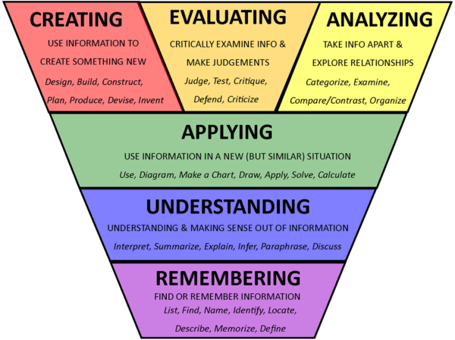
Levels of learning
Levels of inquiry-based learning, from Banchi and Bell (2008) https://www.researchgate.net/publication/281990828_The_many_levels_of_inquiry

Slide 5
ABET Criterion 3
For baccalaureate degree programs, these student outcomes must include, but are not limited to, the following:
an ability to apply knowledge, techniques, skills and modern tools of mathematics, science, engineering, and technology to solve broadly defined engineering problems appropriate to the discipline;
an ability to design systems, components, or processes meeting specified needs for broadly-defined engineering problems appropriate to the discipline;
an ability to apply written, oral, and graphical communication in broadly-defined technical and non-technical environments; and an ability to identify and use appropriate technical literature;
an ability to conduct standard tests, measurements, and experiments and to analyze and interpret the results to improve processes; and
an ability to function effectively as a member as well as a leader on technical teams.

